Slide 1
CHAPTER 7
INTRODUCTION TO FUZZY LOGIC, CLASSICAL SETS AND FUZZY SETS
“Principles of Soft Computing, 2nd Edition”
by S.N. Sivanandam & SN Deepa
Copyright © 2011 Wiley India Pvt. Ltd. All rights reserved.

Slide 2
FUZZY LOGIC
  Fuzzy logic is the logic underlying approximate, rather than exact, modes of reasoning.
  It is an extension of multivalued logic: Everything, including truth, is a matter of degree.
  It contains as special cases not only the classical two-value logic and multivalue logic systems, but also probabilistic logic.
  A proposition p has a truth value
  0 or 1 in two-value system,
  element of a set T in multivalue system,
  Range over the fuzzy subsets of T in fuzzy logic.
“Principles of Soft Computing, 2nd Edition”
by S.N. Sivanandam & SN Deepa
Copyright © 2011 Wiley India Pvt. Ltd. All rights reserved.

Slide 3
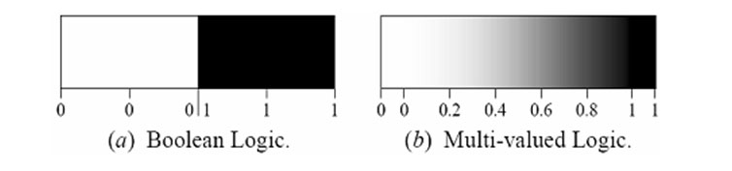
  Boolean logic uses sharp distinctions.
  Fuzzy logic reflects how people think.
  Fuzzy logic is a set of mathematical principles for
  Fuzzy logic is a set of mathematical principles for knowledge representation and reasoning based on degrees of membership.
“Principles of Soft Computing, 2nd Edition”
by S.N. Sivanandam & SN Deepa
Copyright © 2011 Wiley India Pvt. Ltd. All rights reserved.

Slide 4
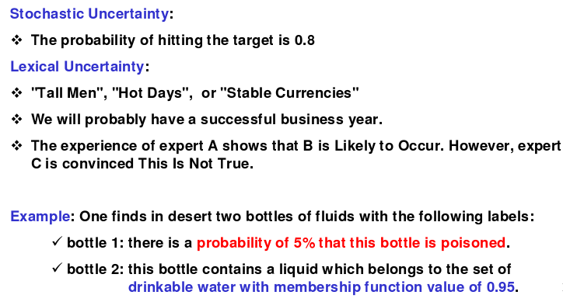
TYPES AND MODELING OF UNCERTAINTY
“Principles of Soft Computing, 2nd Edition”
by S.N. Sivanandam & SN Deepa
Copyright © 2011 Wiley India Pvt. Ltd. All rights reserved.

Slide 5
FUZZY vs PROBABILITY
  Fuzzy ≠ Probability
  Probability deals with uncertainty an likelihood
  Fuzzy logic deals with ambiguity an vagueness
“Principles of Soft Computing, 2nd Edition”
by S.N. Sivanandam & SN Deepa
Copyright © 2011 Wiley India Pvt. Ltd. All rights reserved.

Slide 6
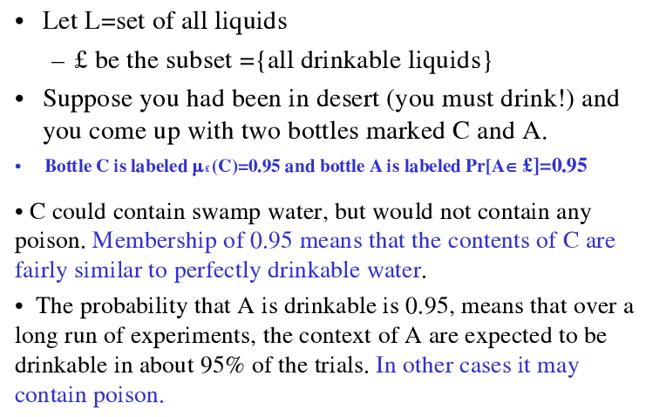
“Principles of Soft Computing, 2nd Edition”
by S.N. Sivanandam & SN Deepa
Copyright © 2011 Wiley India Pvt. Ltd. All rights reserved.

Slide 7
NEED OF FUZZY LOGIC
  Based on intuition and judgment.
  No need for a mathematical model.
  Provides a smooth transition between members and nonmembers.
  Relatively simple, fast and adaptive.
  Less sensitive to system fluctuations.
  Can implement design objectives, difficult to express mathematically, in linguistic or descriptive rules.
“Principles of Soft Computing, 2nd Edition”
by S.N. Sivanandam & SN Deepa
Copyright © 2011 Wiley India Pvt. Ltd. All rights reserved.

Slide 8
CLASSICAL SETS (CRISP SETS)
Conventional or crisp sets are Binary. An element either belongs to the set or does not.
{True, False}
{1, 0}
“Principles of Soft Computing, 2nd Edition”
by S.N. Sivanandam & SN Deepa
Copyright © 2011 Wiley India Pvt. Ltd. All rights reserved.

Slide 9
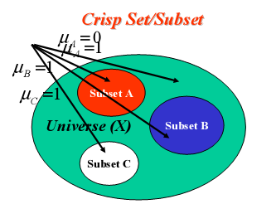
CRISP SETS
“Principles of Soft Computing, 2nd Edition”
by S.N. Sivanandam & SN Deepa
Copyright © 2011 Wiley India Pvt. Ltd. All rights reserved.

Slide 10



OPERATIONS ON CRISP SETS
UNION:
INTERSECTION:
COMPLEMENT:
DIFFERENCE:
“Principles of Soft Computing, 2nd Edition”
by S.N. Sivanandam & SN Deepa
Copyright © 2011 Wiley India Pvt. Ltd. All rights reserved.

Slide 11
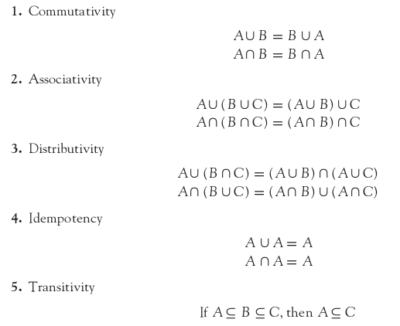
PROPERTIES OF CRISP SETS
The various properties of crisp sets are as follows:
“Principles of Soft Computing, 2nd Edition”
by S.N. Sivanandam & SN Deepa
Copyright © 2011 Wiley India Pvt. Ltd. All rights reserved.

Slide 12
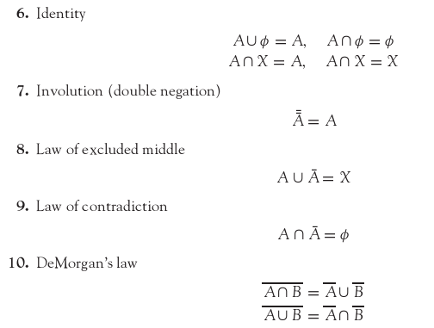
“Principles of Soft Computing, 2nd Edition”
by S.N. Sivanandam & SN Deepa
Copyright © 2011 Wiley India Pvt. Ltd. All rights reserved.

Slide 13
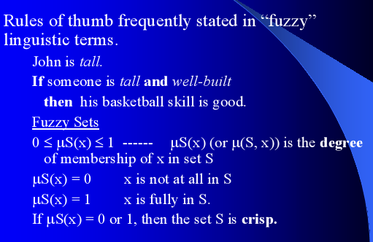
FUZZY SETS
“Principles of Soft Computing, 2nd Edition”
by S.N. Sivanandam & SN Deepa
Copyright © 2011 Wiley India Pvt. Ltd. All rights reserved.

Slide 14
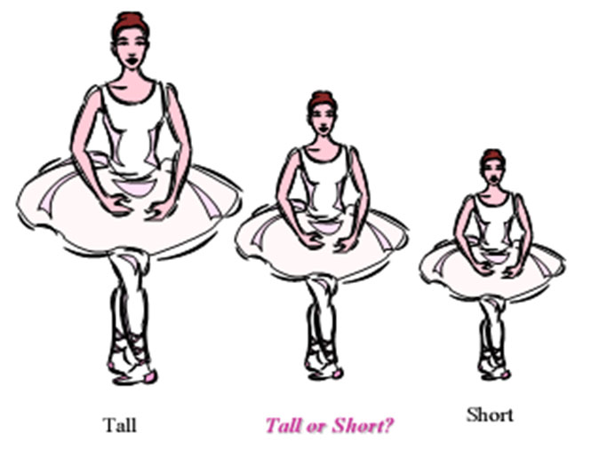
“Principles of Soft Computing, 2nd Edition”
by S.N. Sivanandam & SN Deepa
Copyright © 2011 Wiley India Pvt. Ltd. All rights reserved.

Slide 15

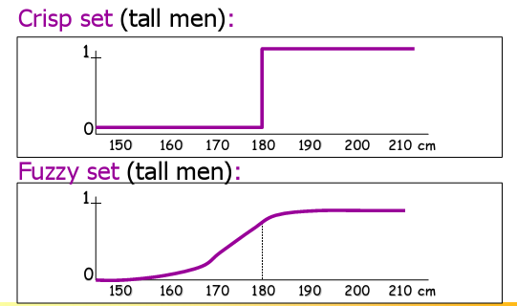
“Principles of Soft Computing, 2nd Edition”
by S.N. Sivanandam & SN Deepa
Copyright © 2011 Wiley India Pvt. Ltd. All rights reserved.

Slide 16
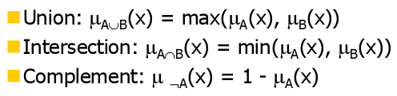
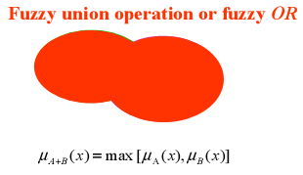
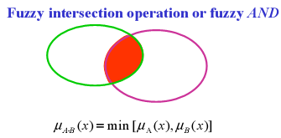
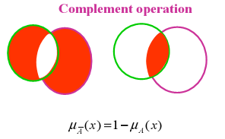
OPERATIONS ON FUZZY SETS
“Principles of Soft Computing, 2nd Edition”
by S.N. Sivanandam & SN Deepa
Copyright © 2011 Wiley India Pvt. Ltd. All rights reserved.

Slide 17
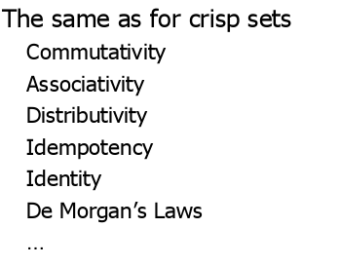
PROPERTIES OF FUZZY SETS
“Principles of Soft Computing, 2nd Edition”
by S.N. Sivanandam & SN Deepa
Copyright © 2011 Wiley India Pvt. Ltd. All rights reserved.

Slide 18
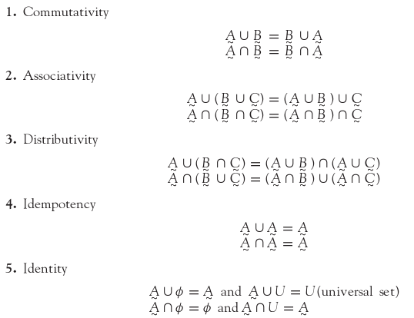
“Principles of Soft Computing, 2nd Edition”
by S.N. Sivanandam & SN Deepa
Copyright © 2011 Wiley India Pvt. Ltd. All rights reserved.

Slide 19
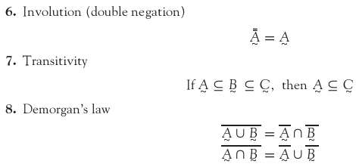
“Principles of Soft Computing, 2nd Edition”
by S.N. Sivanandam & SN Deepa
Copyright © 2011 Wiley India Pvt. Ltd. All rights reserved.

Slide 20
SUMMARY
This chapter discussed the basic concepts of fuzzy logic.
An introduction to crisp sets and fuzzy sets has been included.
The operations and properties of crisp sets and fuzzy sets are also dealt with.
“Principles of Soft Computing, 2nd Edition”
by S.N. Sivanandam & SN Deepa
Copyright © 2011 Wiley India Pvt. Ltd. All rights reserved.

